Slide 1
2023 Planning Guide for Analytics and Artificial Intelligence
Downloadable Figures
Sumit Agarwal, Joe Antelmi
Notes:
Presenter's Name
Presenter's Name

Slide 2
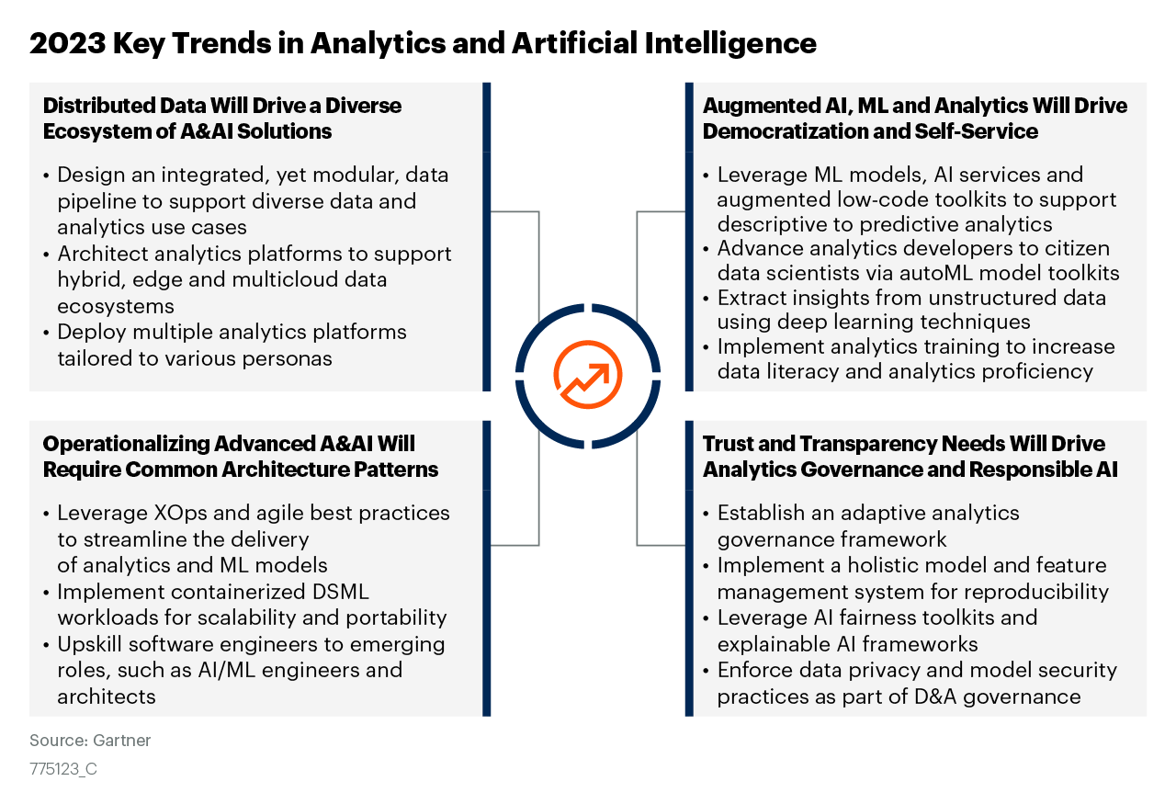
Figure 1

Slide 3
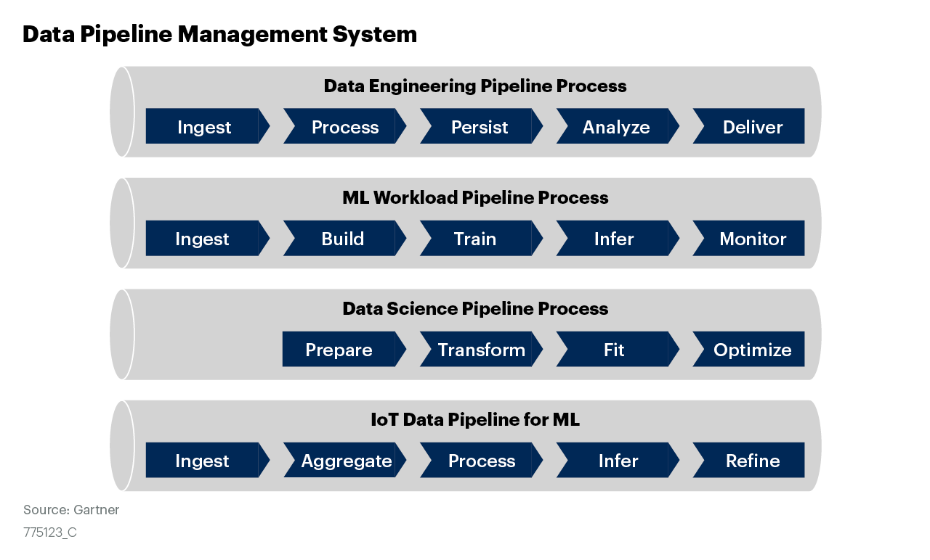
Figure 2

Slide 4
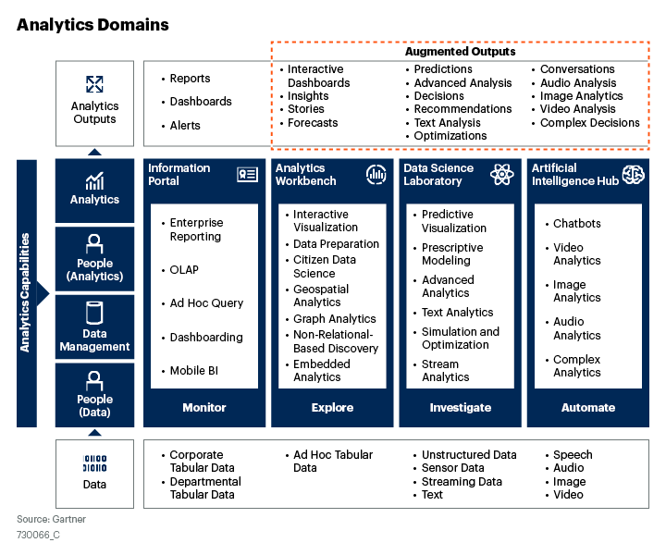
Figure 3

Slide 5
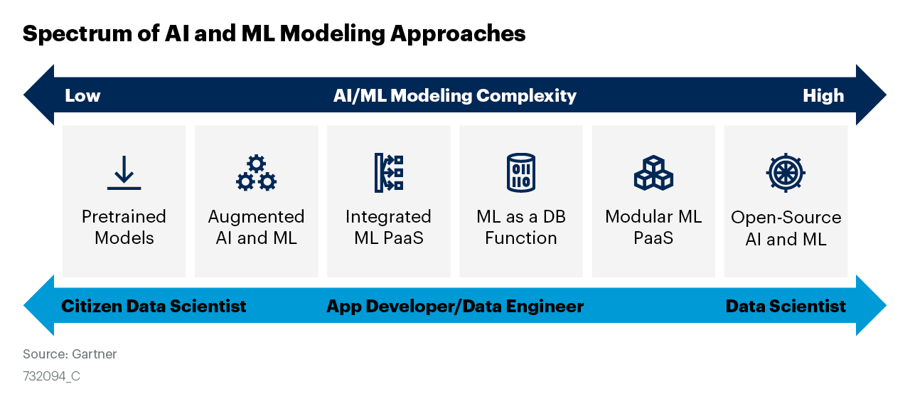
Figure 4

Slide 6
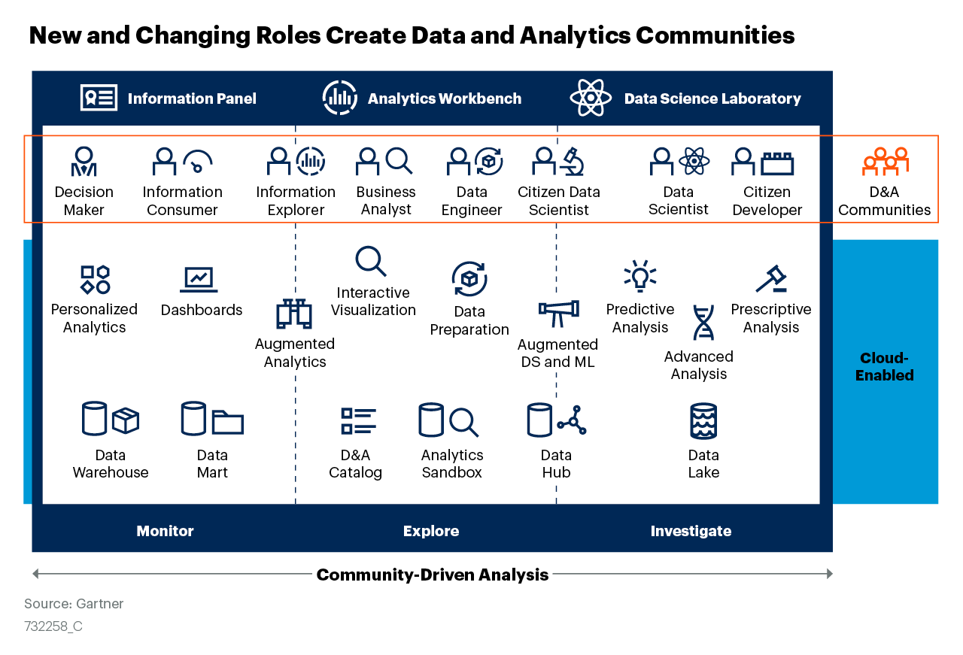
Figure 5

Slide 7
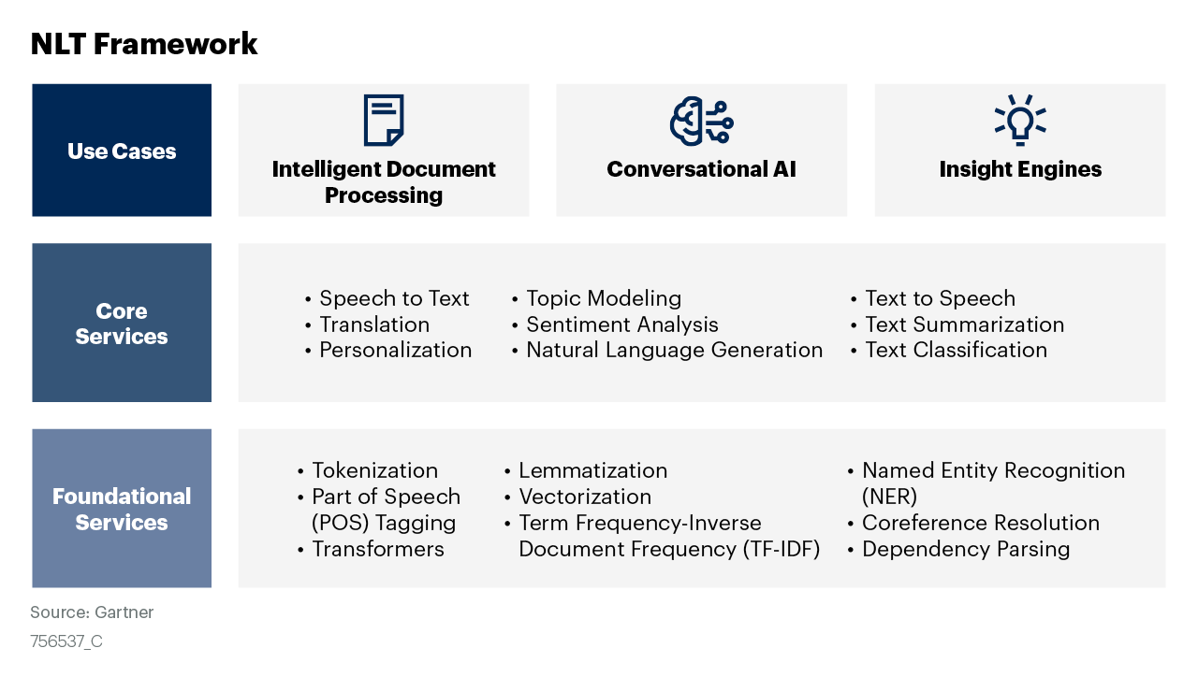
Figure 6

Slide 8
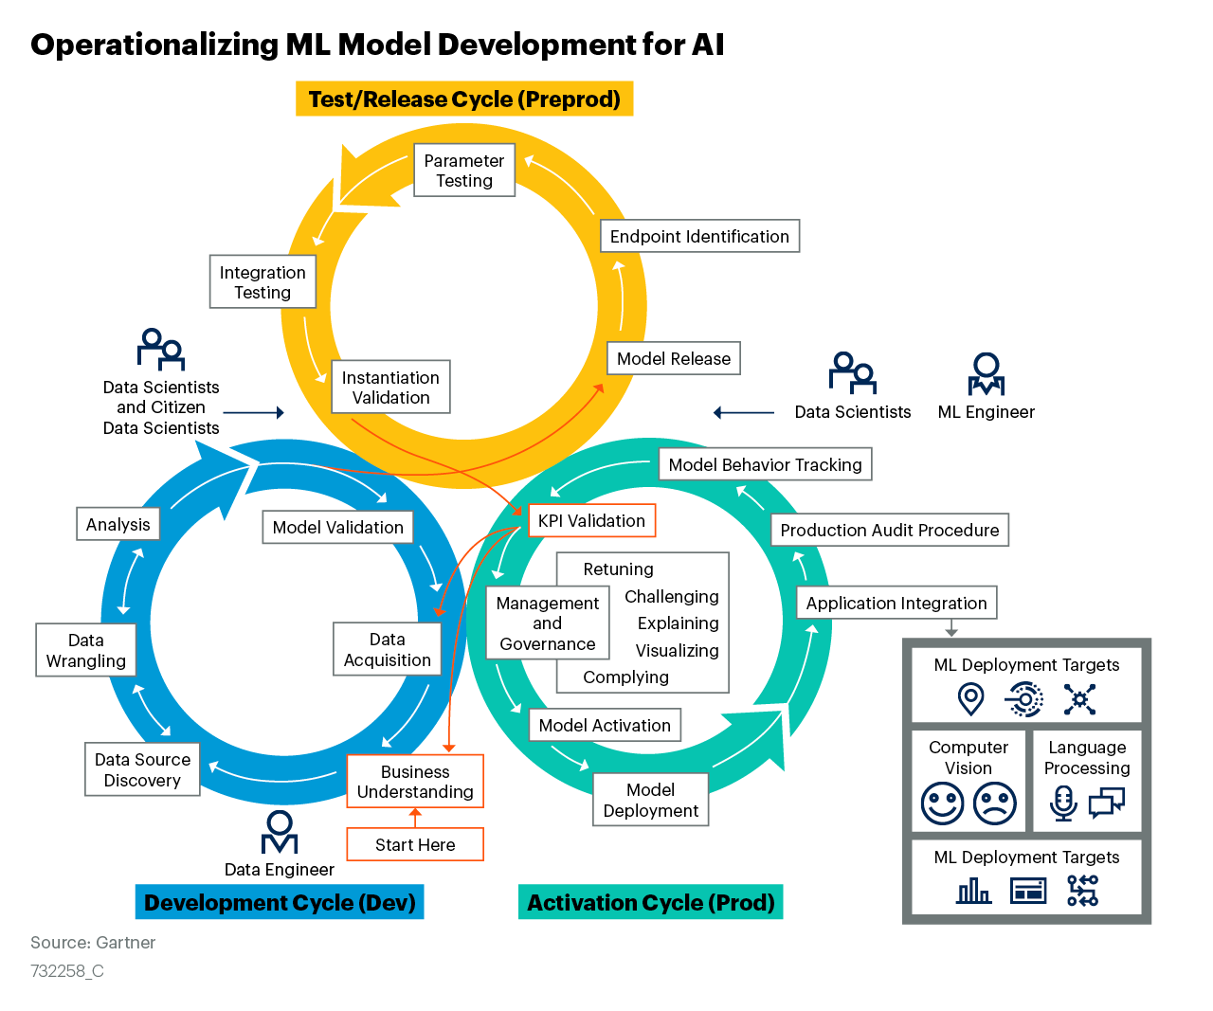
Figure 7

Slide 9
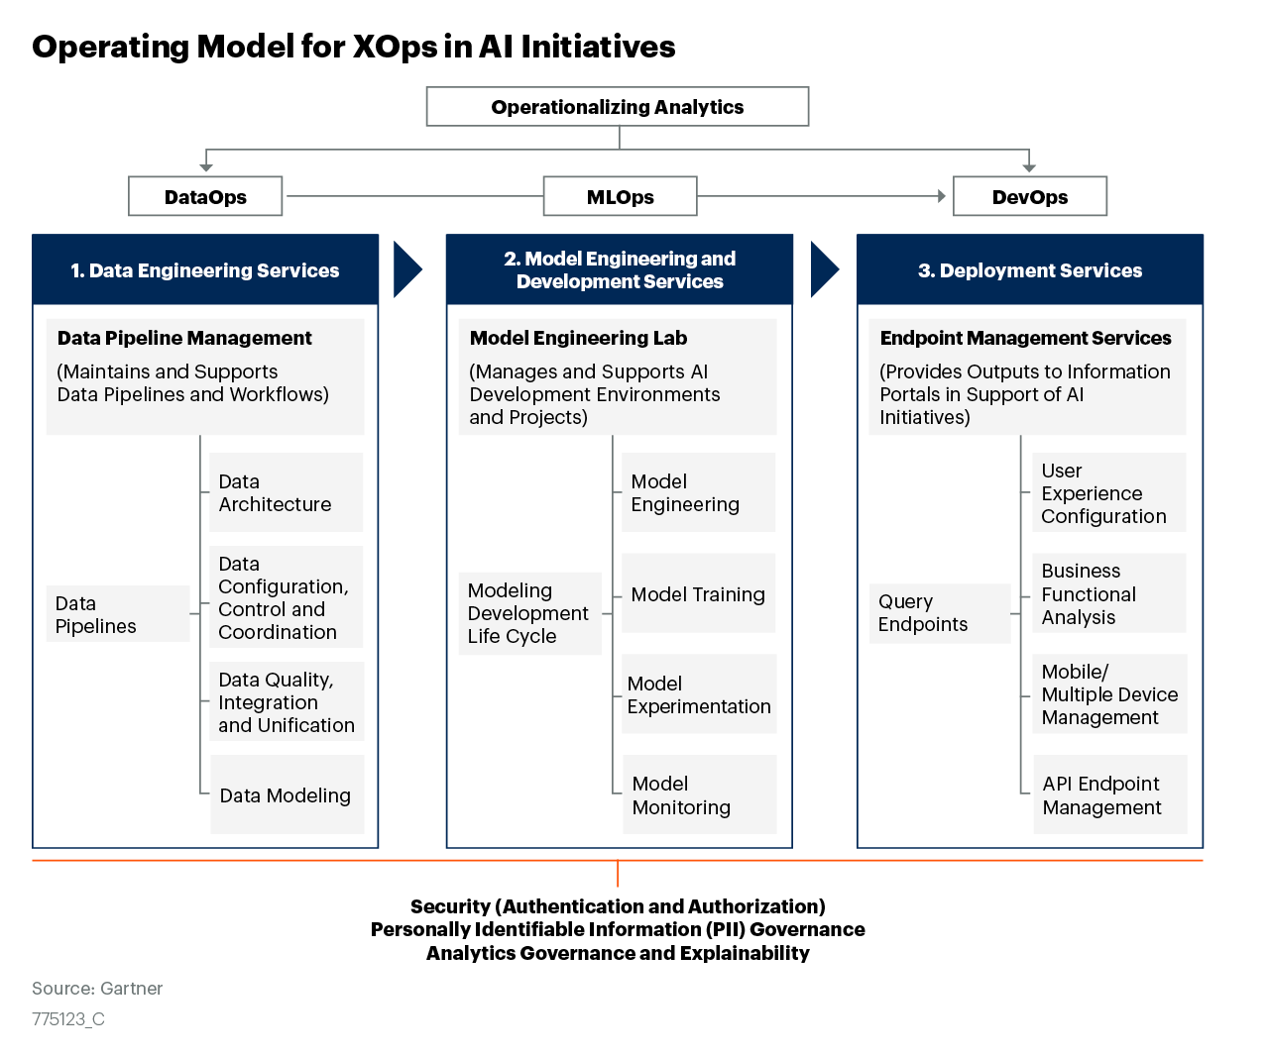
Figure 8

Slide 10
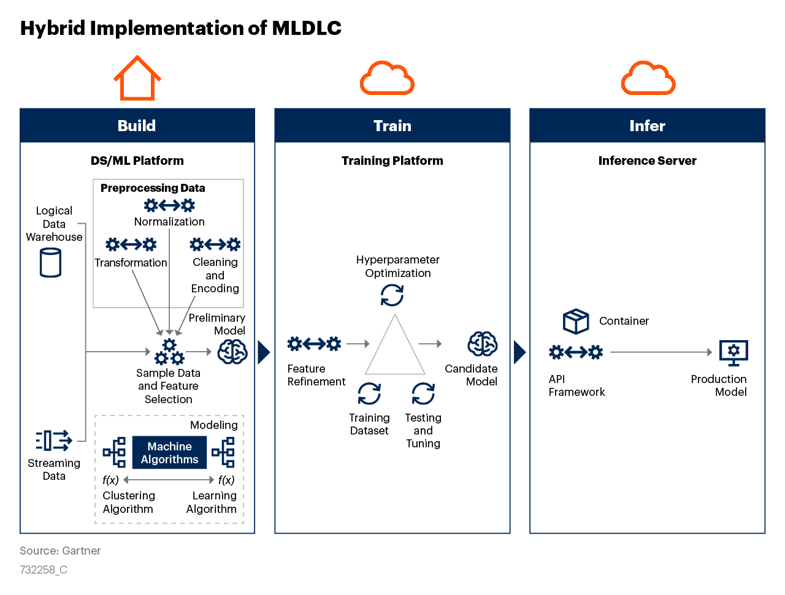
Figure 9

Slide 11
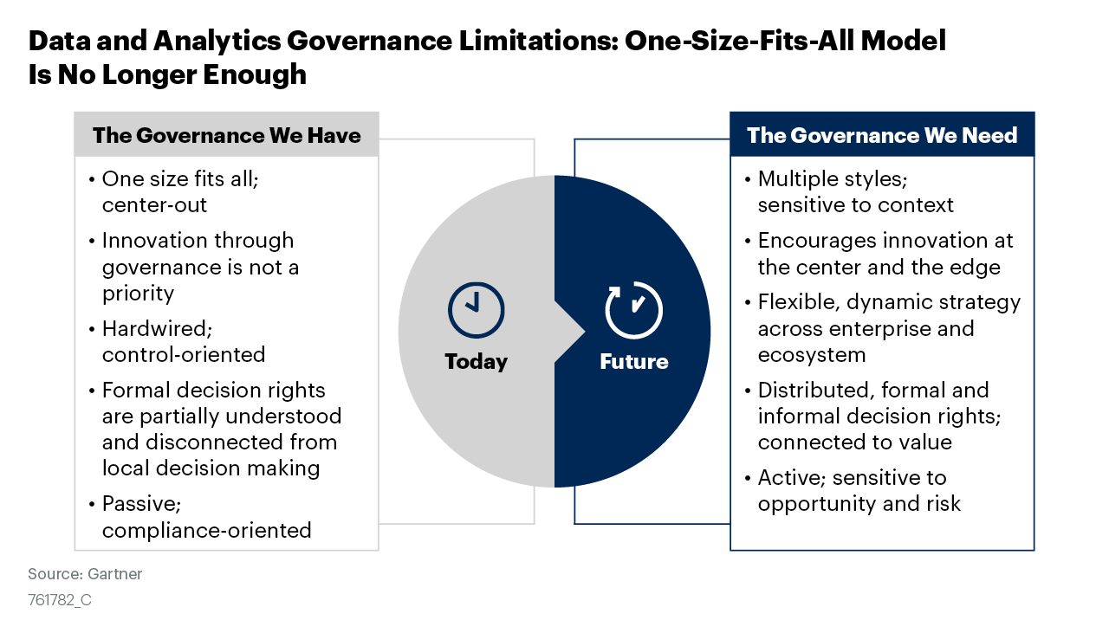
Figure 10

Slide 12
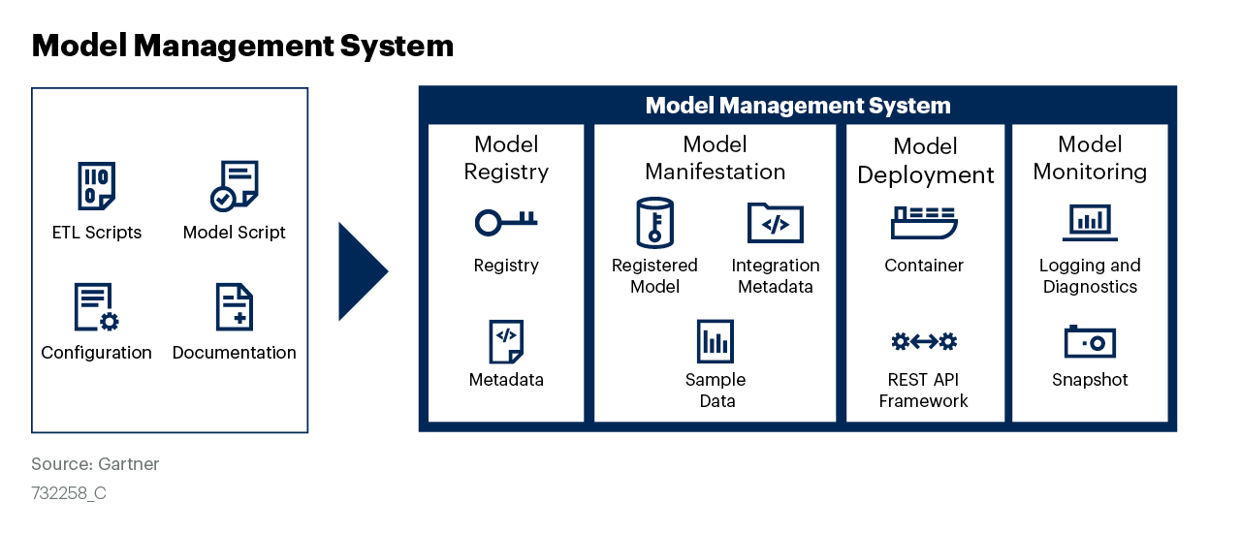
Figure 11

Slide 13
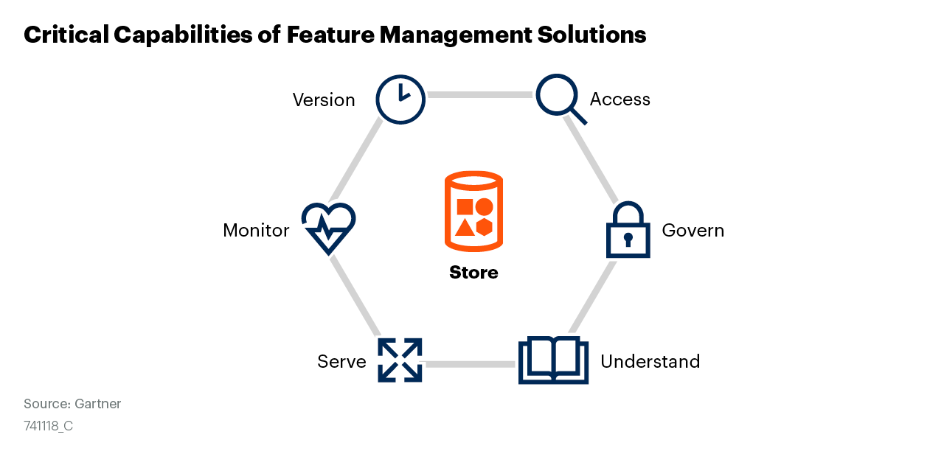
Figure 12

